Slide 1


Oracle database
Lecture 14

Slide 2

Today’s Agenda
Introduction To CONVERSION Functions
The TO_CHAR() Function
The TO_NUMBER() Function
The TO_DATE() Function

Slide 3
Data Type Conversion
Besides utility functions, Oracle inbuilt function library contains Type Conversion functions also.
There may be scenarios where the query expects input in a specific data type, but it receives it in a different data type.
In such cases, Oracle itself implicitly tries to convert the value to a compatible data type and this conversion is called Implicit Conversion

Slide 4
Implicit Conversion Example
For example, examine the below SELECT queries.
Query-1
SELECT employee_id,first_name,salary FROM employees WHERE salary > 15000;
Query-2
SELECT employee_id,first_name,salary FROM employees WHERE salary > '15000';
Both the queries will give the same result because Oracle will automatically convert ‘15000’ to 15000 as same.

Slide 5
Implicit Conversion Types
FROM | TO
VARCHAR2 or CHAR | NUMBER
VARCHAR2 or CHAR | DATE
DATE | VARCHAR2
NUMBER | VARCHAR2

Slide 6
Explicit Conversion
Besides converting values implicitly , Oracle allows us to convert one type to another for displaying or formatting and this is called Explicit Conversion.
For Explicit Conversion , Oracle provides us 3 pre-defined functions and they are:
TO_CHAR()
TO_DATE()
TO_NUMBER()

Slide 7
The Function TO_CHAR()
This function converts a number or date to a string.
Syntax
TO_CHAR(value,[format[)
Arguments:
value : This is the value to convert into String type. This is the main input to the function, and this value can either be a DATE type or Number type.
format: This is the format that the value should be displayed as. If this is omitted, the function will use a default format

Slide 8
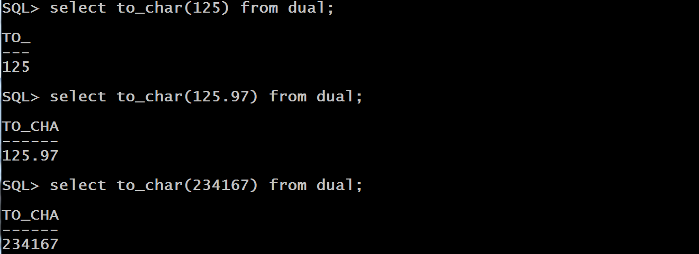
Examples

Slide 9
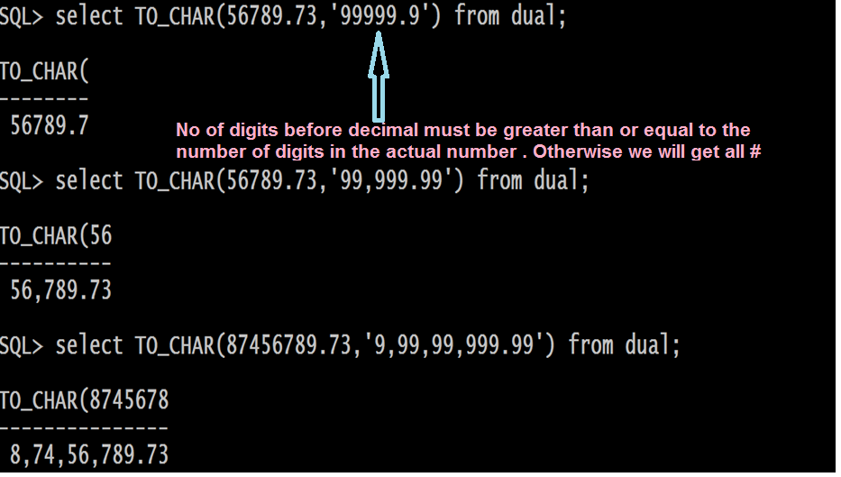
Examples

Slide 10
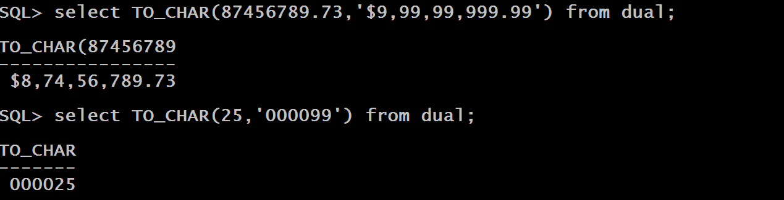
Examples

Slide 11
UsingTO_CHAR() With DATE
TO_CHAR() function is very useful for formatting the internal date data returned by a query in a specific date format.
Following is the format pattern which can be passed as second argument.
Pattern | Meaning
YEAR | Year, spelled out
YYYY | 4-digit year
YYY YY Y | Last 3, 2, or 1 digit(s) of year.

Slide 12
UsingTO_CHAR() With DATE
Pattern | Meaning
Q | Quarter of year (1, 2, 3, 4; JAN-MAR = 1).
MM | Month (01-12; JAN = 01).
MON | Abbreviated name of month.
MONTH | Name of month, padded with blanks to length of 9 characters.
RM | Roman numeral month (I-XII; JAN = I).
WW | Week of year (1-53) where week 1 starts on the first day of the year and continues to the seventh day of the year.
W | Week of month (1-5) where week 1 starts on the first day of the month and ends on the seventh.

Slide 13
UsingTO_CHAR() With DATE
Pattern | Meaning
D | Day of week (1-7).
DAY | Name of day.
DD | Day of month (1-31).
DDD | Day of year (1-366).
DY | Abbreviated name of day.
DDSP | Day Spelled Out
DDTH | Day With Suffix Of TH,ST or RD
DDSPTH | Day Spelled Out With Suffix

Slide 14
UsingTO_CHAR() With DATE
Pattern | Meaning
HH | Hour of day (1-12).
HH12 | Hour of day (1-12).
HH24 | Hour of day (0-23).
MI | Minute (0-59).
SS | Second (0-59).
SSSSS | Seconds past midnight (0-86399).
AM or PM | Time Suffix

Slide 15
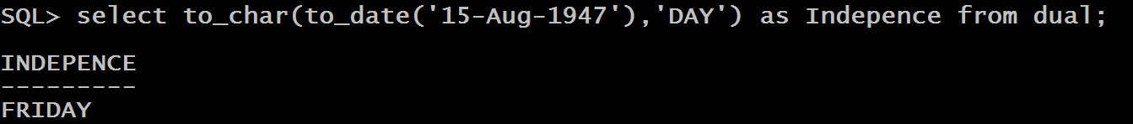
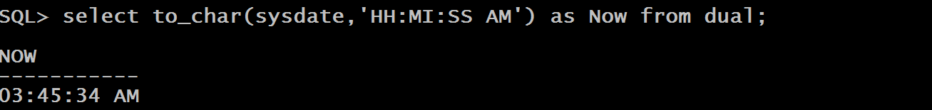
Queries
WAQ to display day of Independence of INDIA
WAQ to display current time in 12 Hour clock

Slide 16
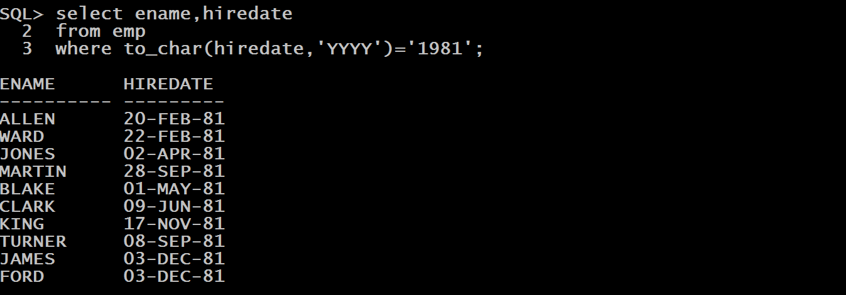
Queries
WAQ to display Ename and Hiredate of all those employees who were hired in the year 1981

Slide 17
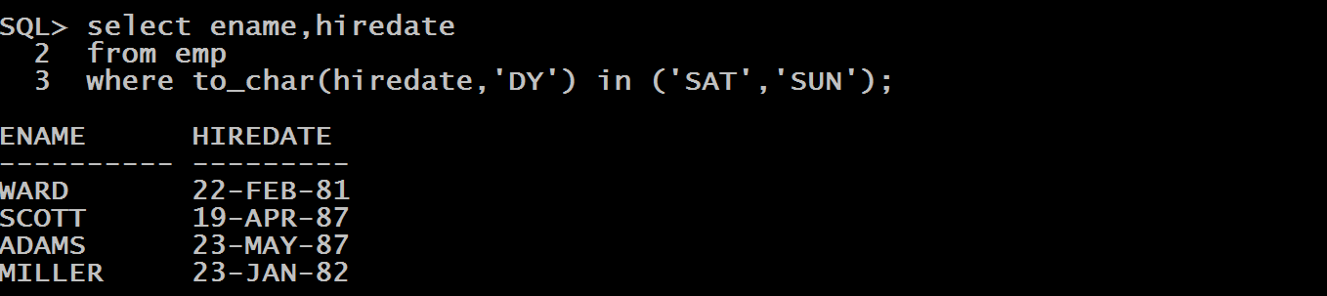
Queries
WAQ to display Ename and Hiredate of all those employees who were hired on weekends irrespective of month and year.

Slide 18
The Function TO_NUMBER()
This function converts a string to number.
Syntax
TO_NUMBER(str,format)
Arguments:
str: This is the string to be converted into Number type
format: This is the format that the string should be displayed as. If this is omitted, the function will use a default format

Slide 19
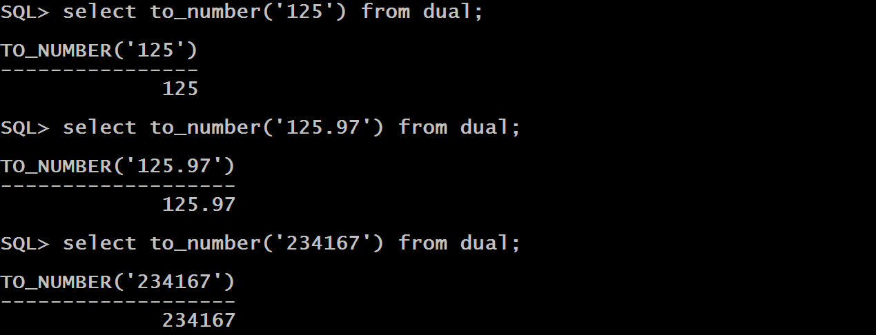
Examples

Slide 20
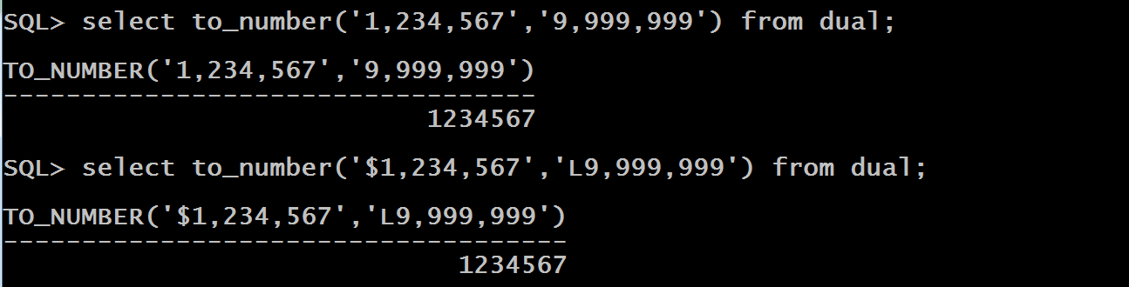
Examples

Slide 21
The Function TO_DATE()
This function converts a string to date.
Syntax
TO_DATE(str,format)
Arguments:
str: This is the string to be converted into Date type
format: This is the format in which the string is . If this is omitted, Oracle will expect the string to be in DD-MON-YY format.

Slide 22
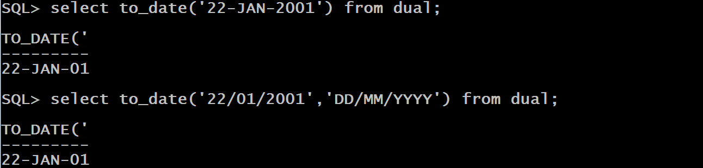
Examples

Slide 23
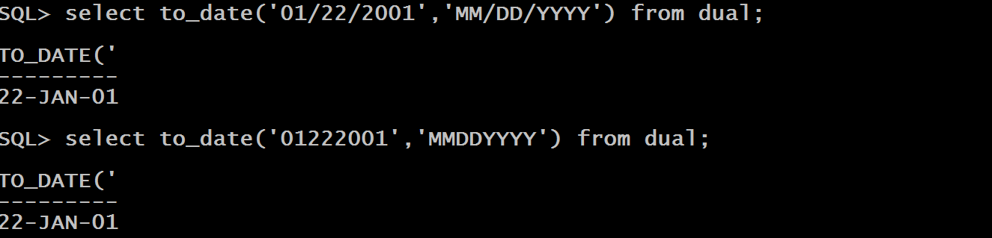
Examples

